Slide 1

Chapter 29
Cryptography
and
Network
Security
Copyright © The McGraw-Hill Companies, Inc. Permission required for reproduction or display.

Slide 2
OBJECTIVES:
To introduce security goals and to discuss the types of attacks that threaten these goals.
To introduce traditional ciphers as symmetric-key ciphers to create the background for understanding modern symmetric-key ciphers.
To introduce the elements of modern block ciphers and show an example of a modern block cipher in which these elements are used.
To discuss the general idea behind asymmetric-key ciphers and introduce one common cipher in this category.
To discuss message integrity and show how to use a cryptographic hash function to create a message digest.

Slide 3
OBJECTIVES (continued):
To introduce the idea of message authentication and show how a message digest combined with a secret can authenticate the sender.
To show how the idea of digital signatures can be used to authenticate a message using a pair of private-public keys.
To introduce the idea of entity authentication and show some simple schemes using either a secret key or a pair of private-public keys.
To show how secret keys in symmetric-key cryptography and how public keys in asymmetric-key cryptography can be distributed and managed using KDCs or certificate authorities (CAs).

Slide 4
Chapter
Outline
29.1 Introduction
29.2 Traditional Ciphers
29.3 Modern Ciphers
29.4 Asymmetric-Key Ciphers
29.5 Message Integrity
29.6 Message Authentication
29.7 Digital Signature
29.8 Entity Authentication
29.9 Key Management

Slide 5
29-1 INTRODUCTION
We are living in the information age. We need to keep information about every aspect of our lives. In other words, information is an asset that has a value like any other asset. As an asset, information needs to be secured from attacks. To be secured, information needs to be hidden from unauthorized access (confidentiality), protected from unauthorized change (integrity), and available to an authorized entity when it is needed (availability).

Slide 6
Topics Discussed in the Section
Security Goals
Attacks
Services
Techniques

Slide 7
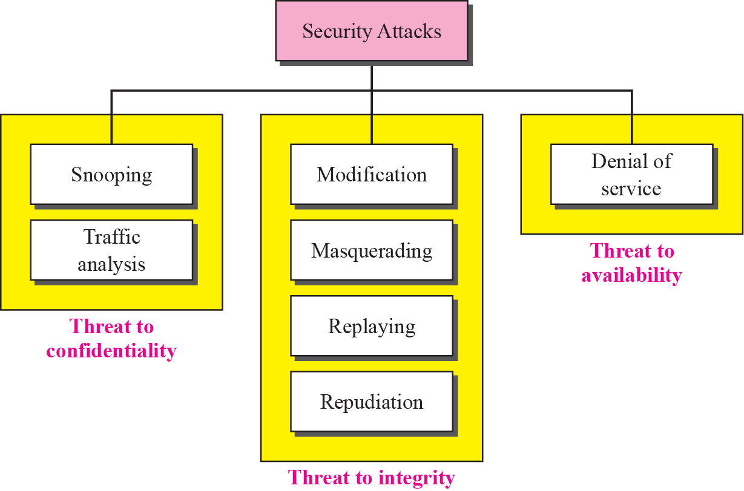
Figure 29.1 Taxonomy of attacks with relation to security goals

Slide 8
29-2 TRADITIONAL CIPHERS
We now look at the first goal of security, confidentiality. Confidentiality can be achieved using ciphers. Traditional ciphers are called symmetric-key ciphers (or secret-key ciphers) because the same key is used for encryption and decryption and the key can be used for bidirectional communication. Figure 29.2 shows the general idea behind a symmetric-key cipher.

Slide 9
Topics Discussed in the Section
Key
Substitution Ciphers
Transposition Ciphers
Stream and Block Ciphers

Slide 10
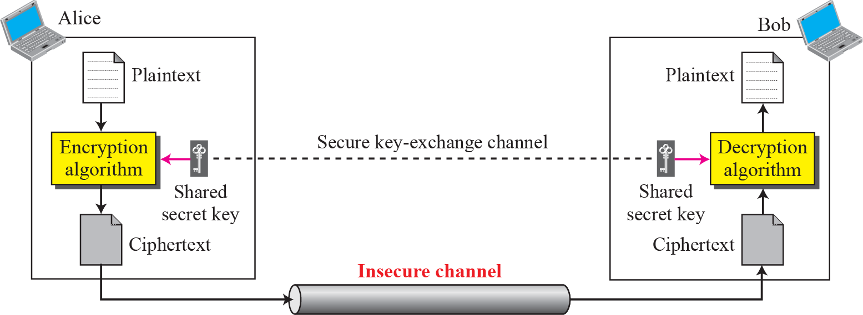
Figure 29.2 General idea of traditional cipher

Slide 11

Note
A substitution cipher replaces one symbol with another.

Slide 12
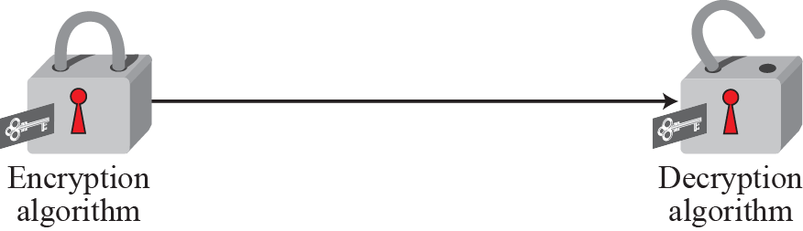
Figure 29.3 Symmetric-key: locking and unlocking with the same key

Slide 13
Note
A substitution cipher replaces one symbol with another.

Slide 14
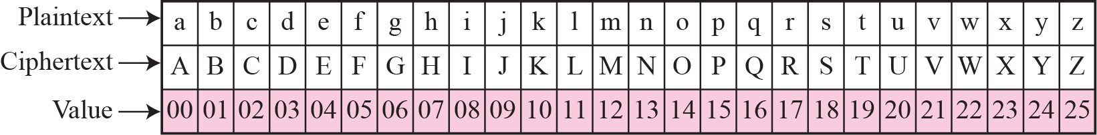
Figure 29.4 Representation of characters in modulo 26

Slide 15
Note
In additive cipher, the plaintext, ciphertext, and key are integers in modulo 26.

Slide 16
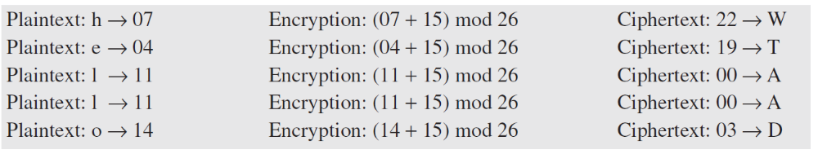
Example 29.1
Use the additive cipher with key = 15 to encrypt the message “hello”.
Solution
We apply the encryption algorithm to the plaintext, character by character. The result is “WTAAD”. Note that the cipher is monoalphabetic because two instances of the same plaintext character (ls) are encrypted as the same character (A).

Slide 17
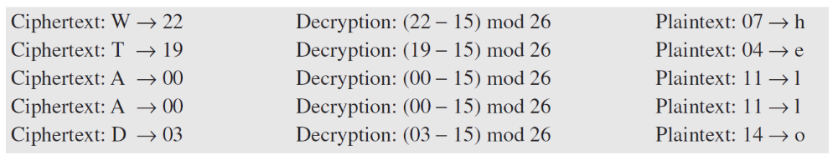
Example 29.2
Use the additive cipher with key = 15 to decrypt the message “WTAAD”.
Solution
We apply the decryption algorithm to the plaintext character by character. The result is “hello”. Note that the operation is in modulo 26, which means that we need to add 26 to a negative result (for example −15 becomes 11).

Slide 18
Figure 29.5 An example key for mono-alphabetic substitution cipher

Slide 19
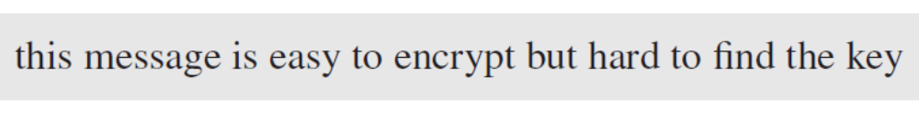
Example 29.3
We can use the key in Figure 29.5 to encrypt the message
The ciphertext is

Slide 20
Note
A transposition cipher reorders symbols.

Slide 21
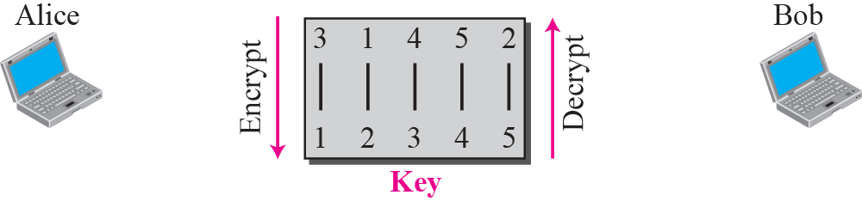
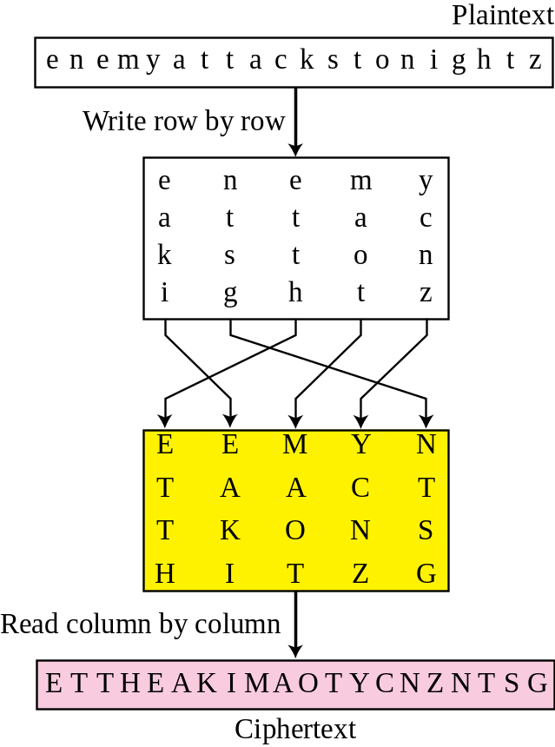
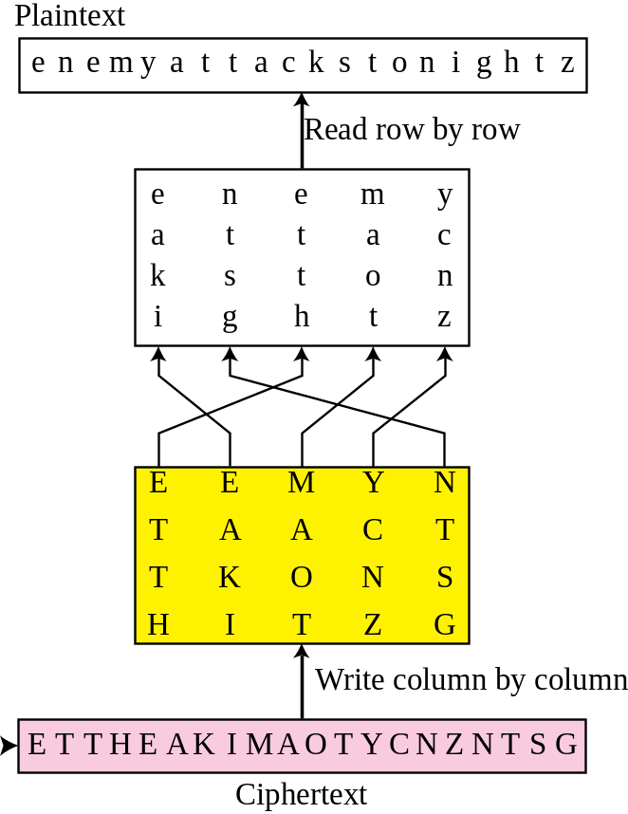
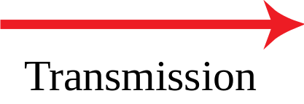
Figure 29.6 Transposition cipher

Slide 22
29-3 MODERN CIPHERS
The traditional symmetric-key ciphers that we have studied so far are character-oriented ciphers. With the advent of the computer, we need bit-oriented ciphers. This is because the information to be encrypted is not just text; it can also consist of numbers, graphics, audio, and video data. It is convenient to convert these types of data into a stream of bits, to encrypt the stream, and then to send the encrypted stream. A modern block cipher can be either a block cipher or a stream cipher.

Slide 23
Topics Discussed in the Section
Modern Block Ciphers
Data Encryption Standard (DES)
Modern Stream Ciphers

Slide 24
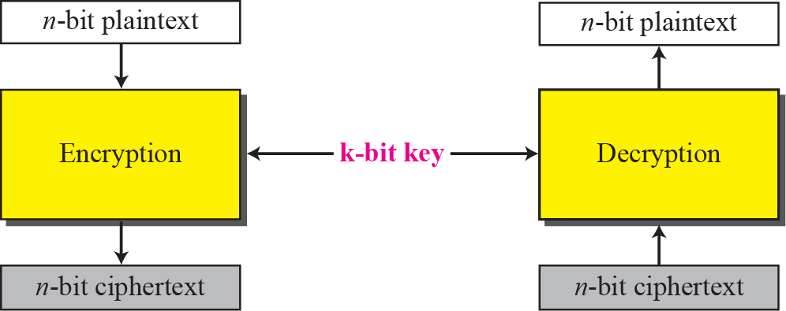
Figure 29.7 A modern block cipher

Slide 25
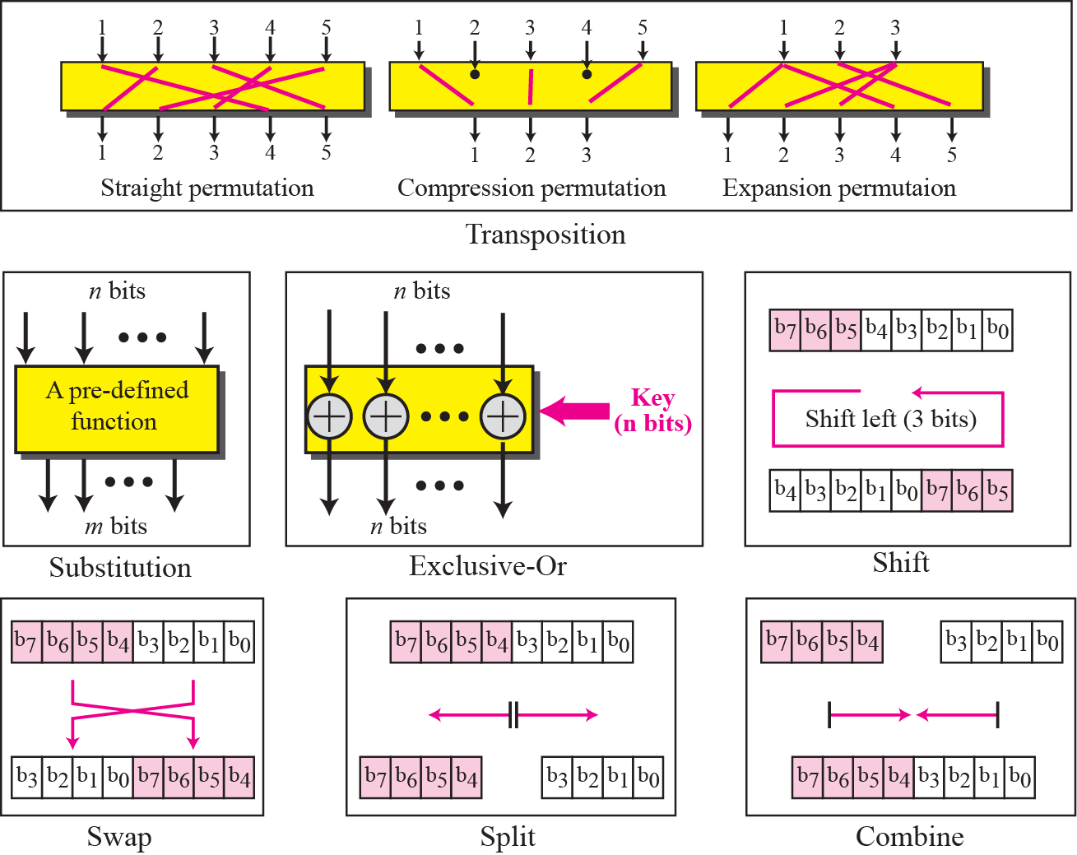
Figure 29.8 Components of a modern block cipher

Slide 26
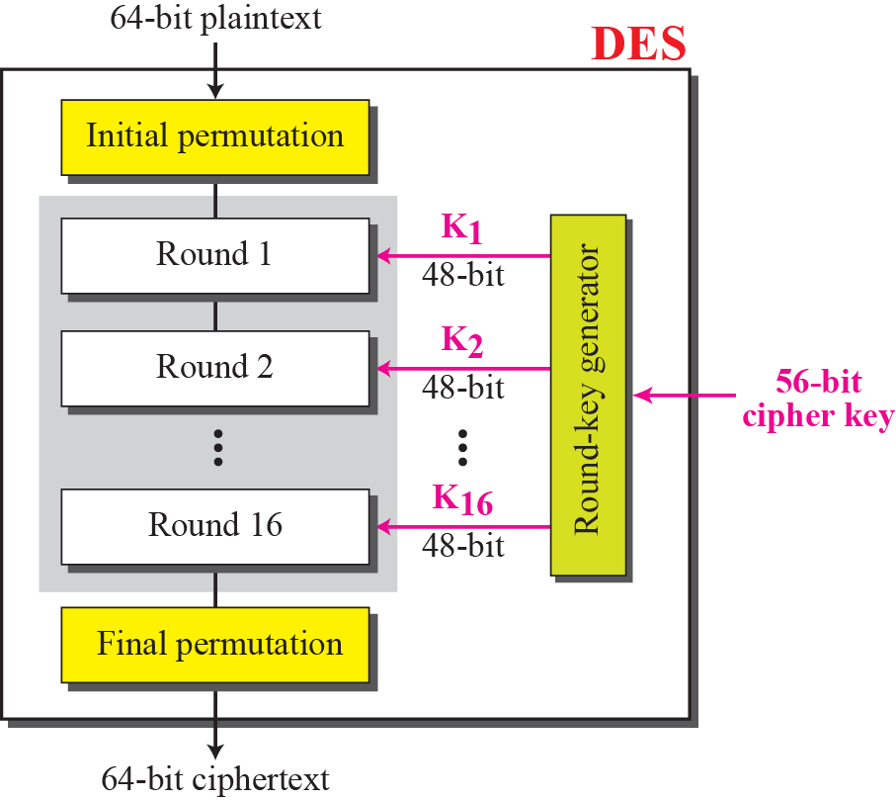
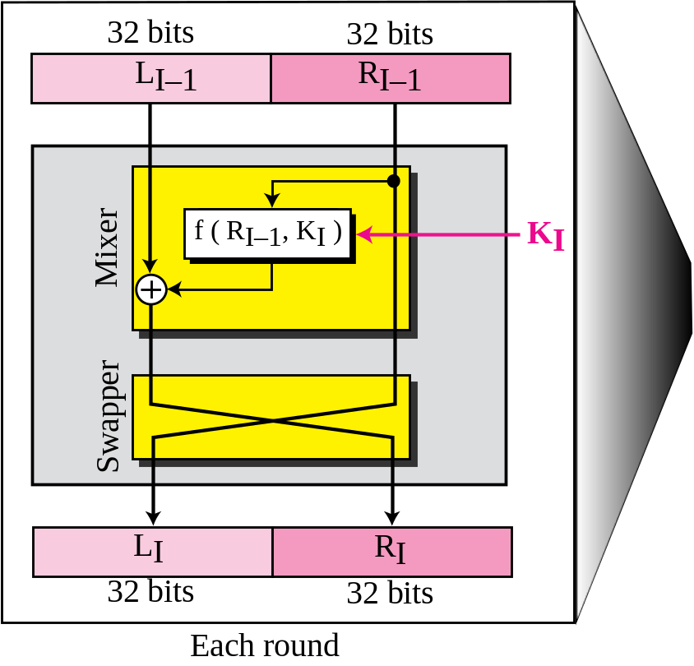
Figure 29.9 General structure of DES

Slide 27
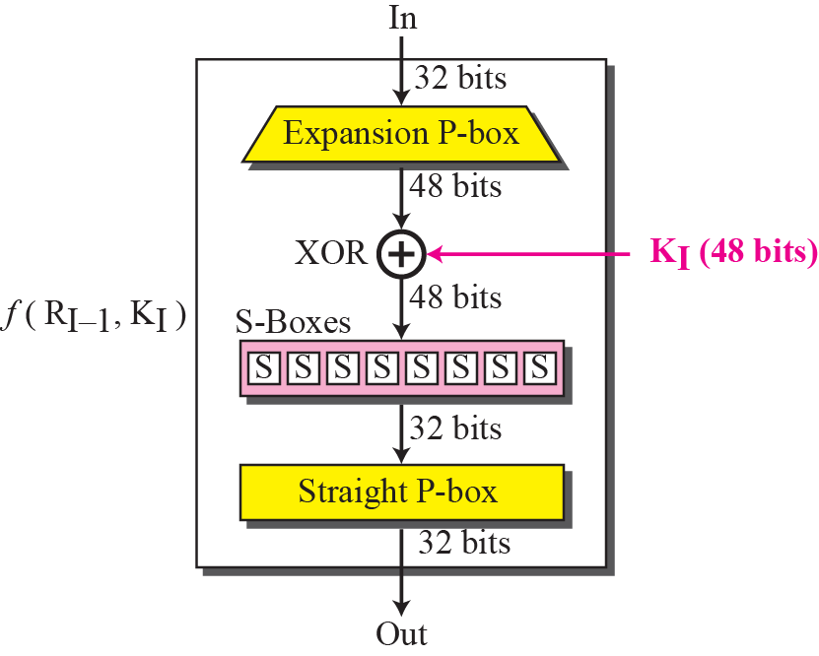
Figure 29.10 DES function

Slide 28
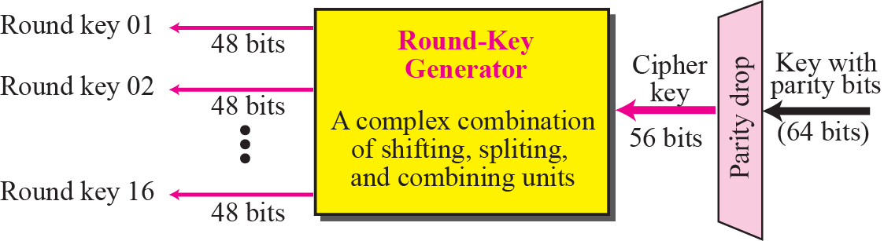
Figure 29.11 Key generation

Slide 29
Example 29.4
We choose a random plaintext block, a random key, and a computer program to determine what the ciphertext block would be (all in hexadecimal):

Slide 30
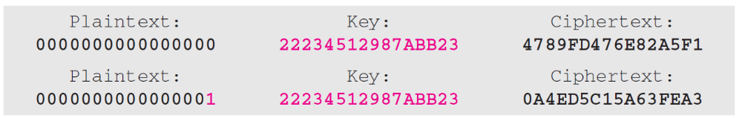
Example 29.5
To check the effectiveness of DES, when a single bit is changed in the input, let us use two different plaintexts with only one single bit difference. The two ciphertexts are completely different without even changing the key:
Although the two plaintext blocks differ only in the rightmost bit, the ciphertext blocks differ in 29 bits.

Slide 31
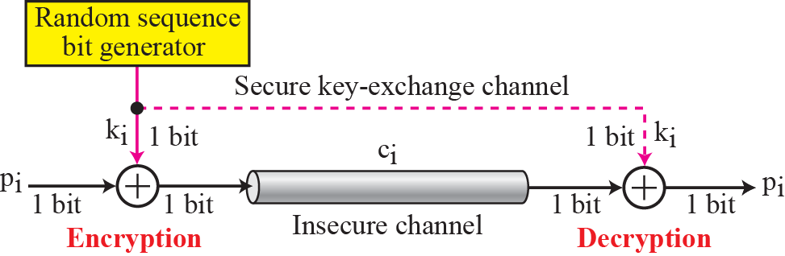
Figure 29.12 One-time pad

Slide 32
29-4 ASYMMETRIC-KEY CIPHERS
In previous sections we discussed symmetric-key ciphers. In this chapter, we start the discussion of asymmetric-key ciphers. Symmetric-key and asymmetric-key ciphers will exist in parallel and continue to serve the community. We actually believe that they are complements of each other; the advantages of one can compensate for the disadvantages of the other.

Slide 33
Topics Discussed in the Section
Keys
General Idea
RSA Cryptosystem
Applications

Slide 34
Note
Symmetric-key cryptography is based on sharing secrecy;
asymmetric-key cryptography is based on personal secrecy.

Slide 35
Note
In symmetric-key cryptography, symbols are permuted or substituted;
in asymmetric-key cryptography, numbers are manipulated.

Slide 36
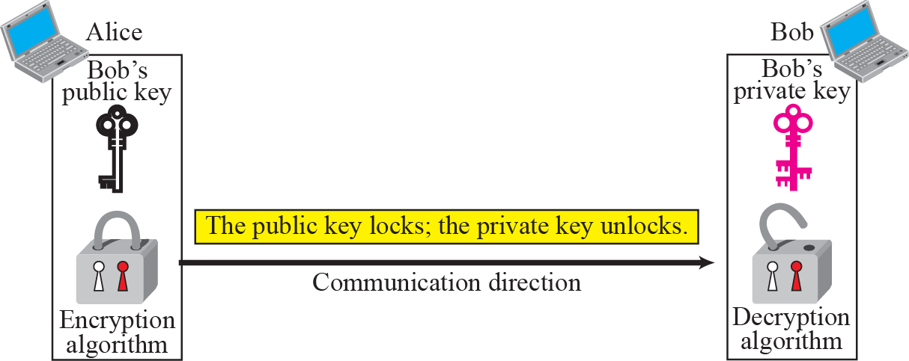
Figure 29.13 Locking and unlocking in asymmetric-key cryptosystem

Slide 37
Note
Asymmetric-key ciphers are sometimes called public-key ciphers.

Slide 38
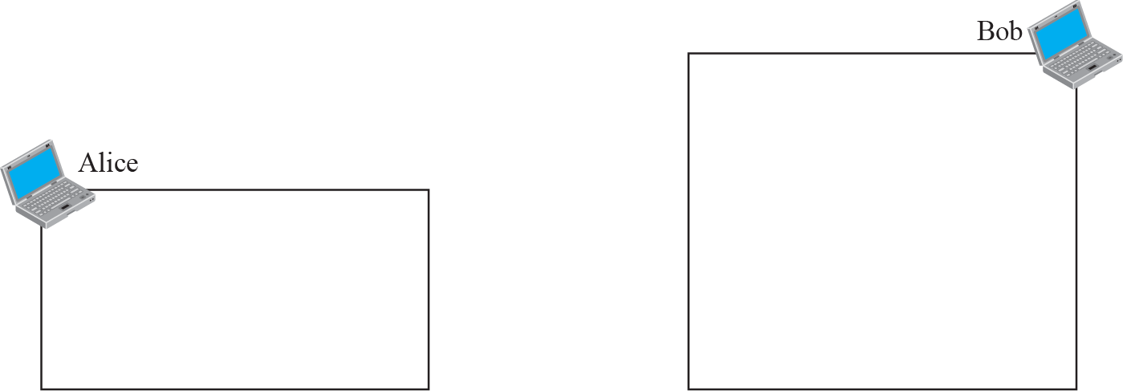
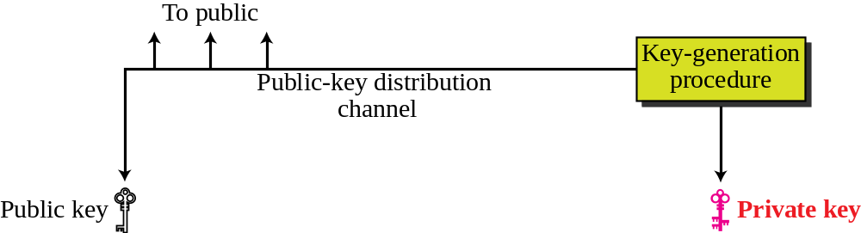
Figure 29.14 General idea of asymmetric-key cryptosystem

Slide 39
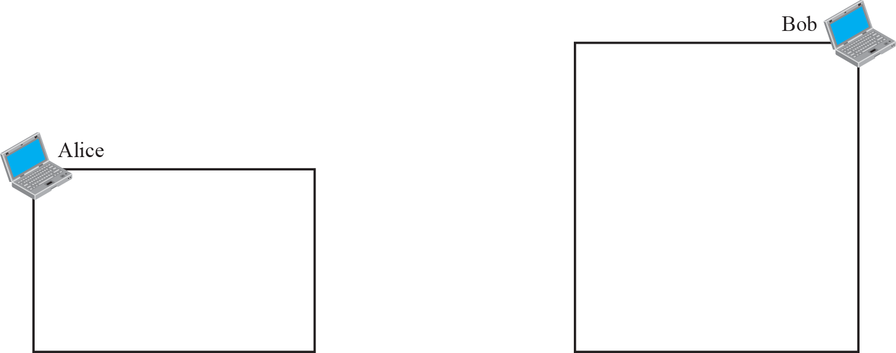
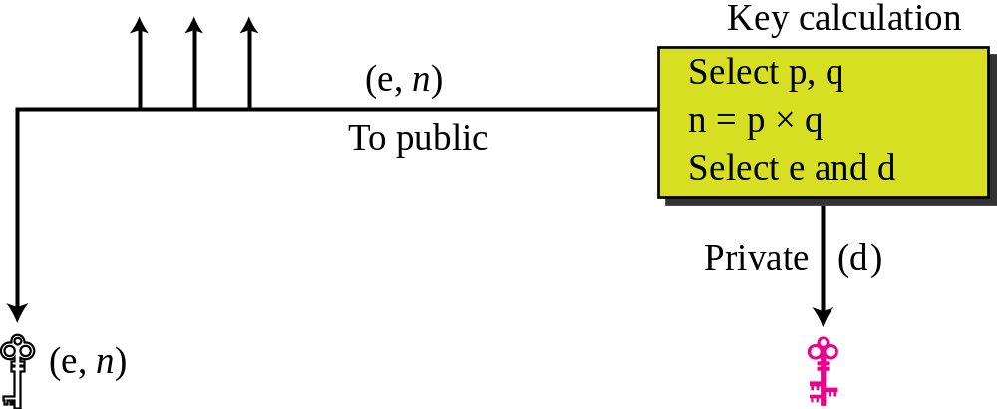
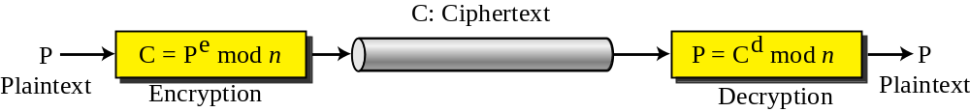
Figure 29.15 Encryption, decryption, and key Generation in RSA

Slide 40
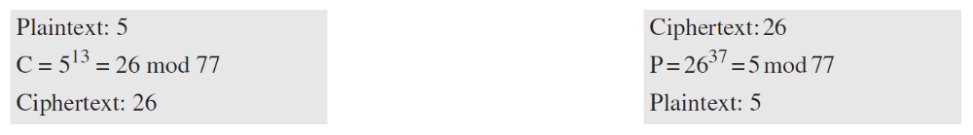
Example 29.6
For the sake of demonstration, let Bob choose 7 and 11 as p and q and calculate n = 7 × 11 = 77. The value of φ(n) =
(7 − 1)(11 − 1), or 60. If he chooses e to be 13, then d is 37. Note that e × d mod 60 = 1. Now imagine that Alice wants to send the plaintext 5 to Bob. She uses the public exponent 13 to encrypt 5. This system is not safe because p and q are small.

Slide 41
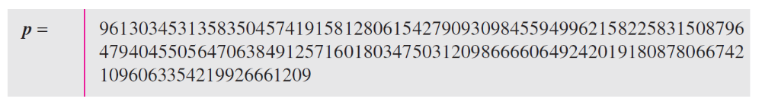
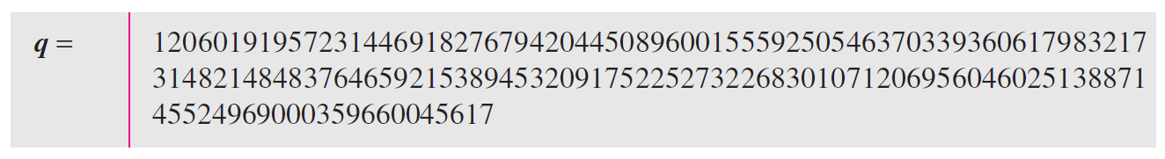
Example 29.7
Here is a more realistic example calculated with a computer. We choose a 512-bit p and q, calculate n and φ(n), We then choose e and calculate d. Finally, we show the results of encryption and decryption. The integer p is a 159-digit number.
The integer q is a 160-digit number.

Slide 42
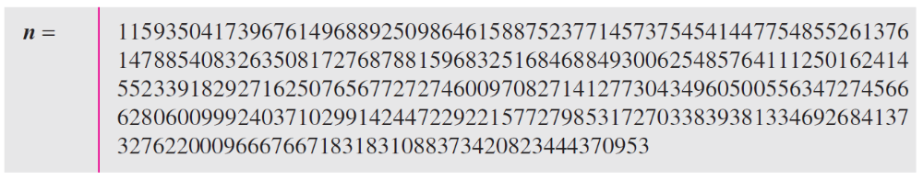
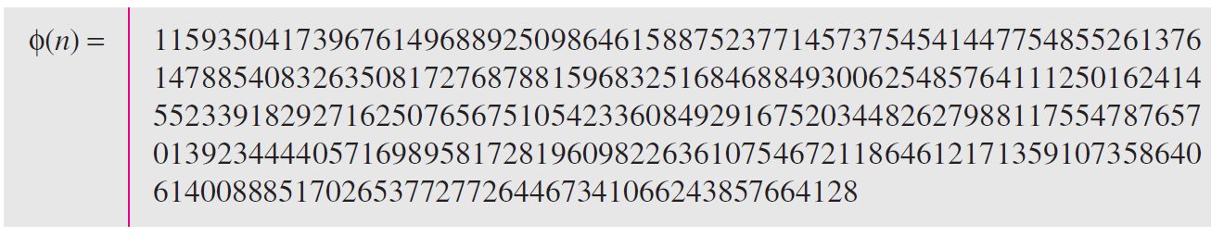
Example 29.7 Continued
The modulus n = p × q. It has 309 digits.
φ(n) = (p − 1)(q − 1) has 309 digits.

Slide 43
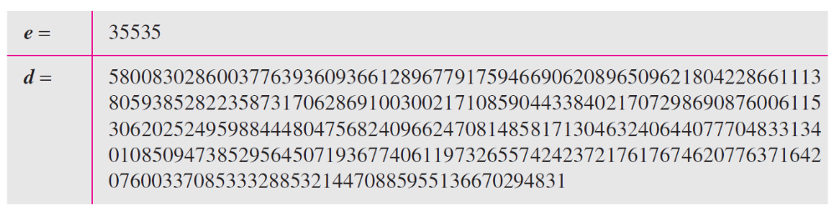
Example 29.7 Continued
Bob chooses e = 35535 (the ideal is 65537). He then finds d.
Alice wants to send the message “THIS IS A TEST”, which can be changed to a numeric value using the 00−26 encoding scheme (26 is the space character).

Slide 44
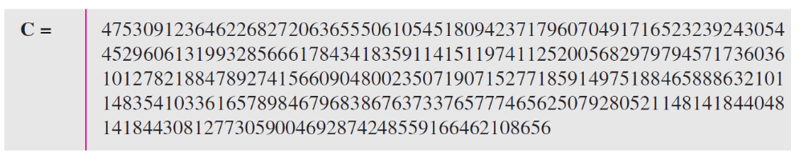
Example 29.7 Continued
The ciphertext calculated by Alice is C = P^{e}, which is
Bob can recover the plaintext from the ciphertext using P = C^{d}, which is
The recovered plaintext is “THIS IS A TEST” after decoding.

Slide 45
29-5 MESSAGE INTEGRITY
The cryptography systems that we have studied so far provide secrecy, or confidentiality, but not integrity. However, there are occasions where we may not even need secrecy but instead must have integrity. For example, Alice may write a will to distribute her estate upon her death. The will does not need to be encrypted. After her death, anyone can examine the will. The integrity of the will, however, needs to be preserved. Alice does not want the contents of the will to be changed.

Slide 46
Topics Discussed in the Section
Message and Message Digest
Hash Functions

Slide 47
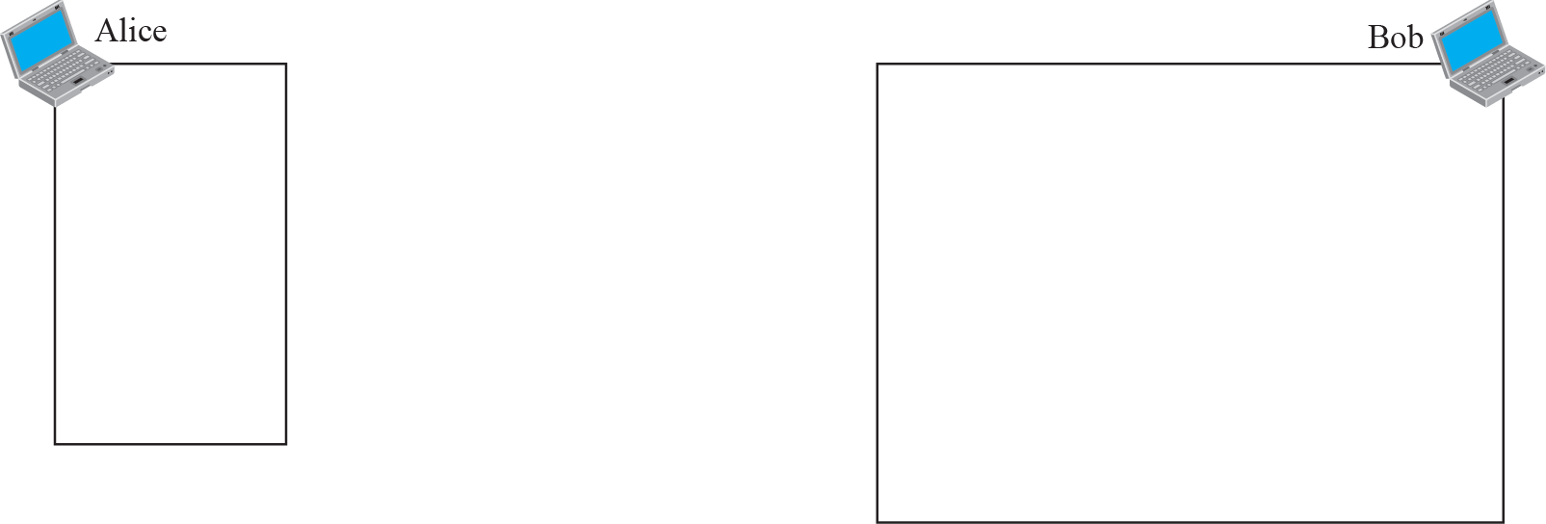
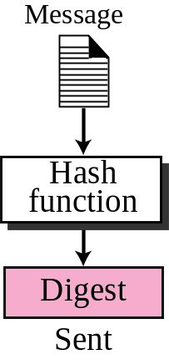
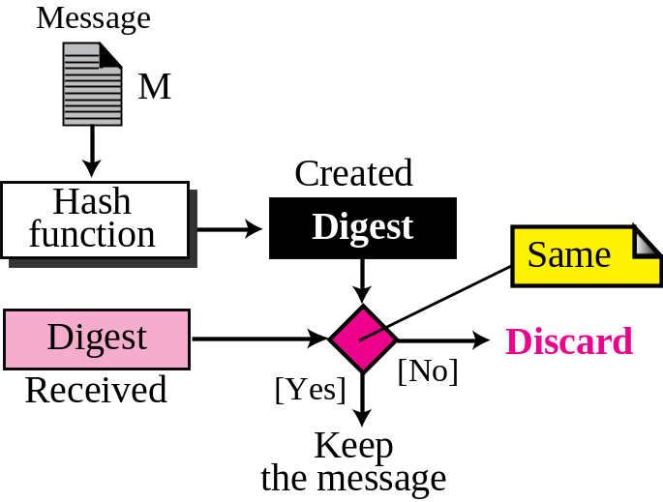
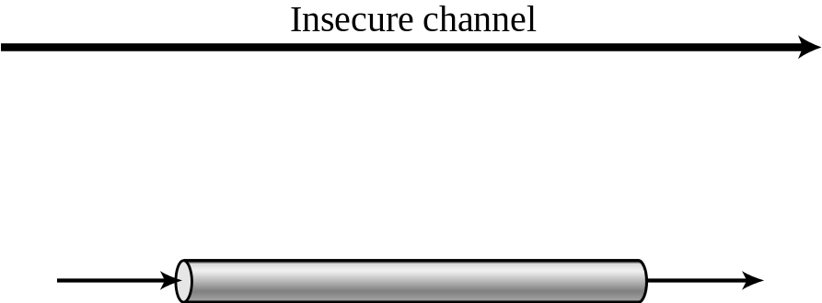
Figure 29.16 Message and digest

Slide 48
Note
The message digest needs to be safe from change.

Slide 49
29-6 MESSAGE AUTHENTICATION
A digest can be used to check the integrity of a message: that the message has not been changed. To ensure the integrity of the message and the data origin authentication— that Alice is the originator of the message, not somebody else—we need to include a secret held by Alice (that Eve does not possess) in the process; we need to create a message authentication code (MAC). Figure 29.17 shows the idea.

Slide 50
Topics Discussed in the Section
MAC
HMAC

Slide 51
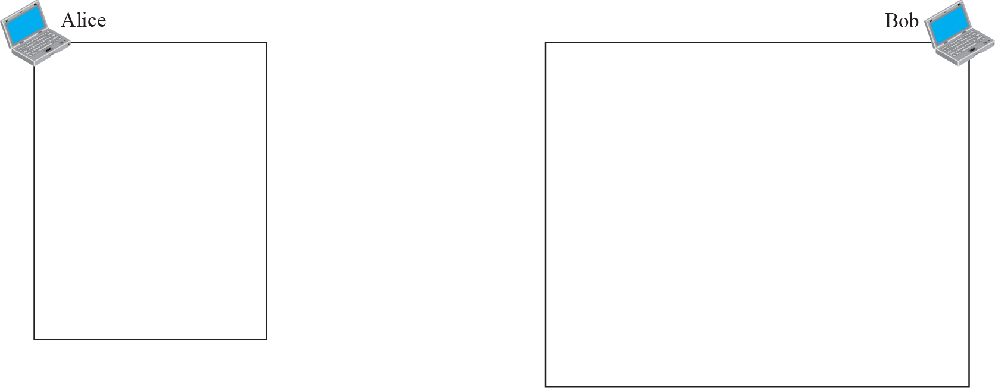
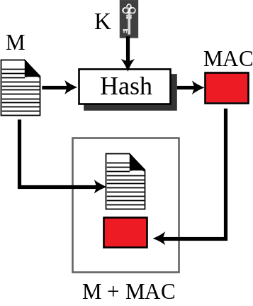
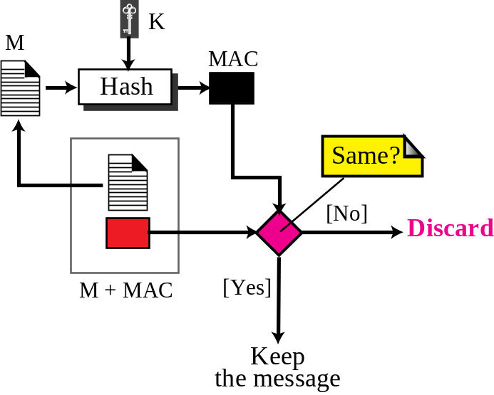
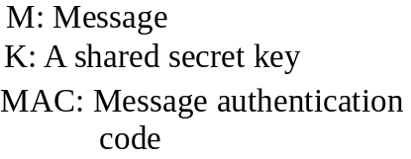
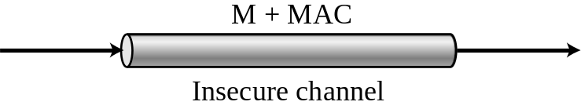
Figure 29.17 Message authentication code

Slide 52
Note
A MAC provides message integrity
and message authentication using a combination of a hash function and a secret key.

Slide 53
29-7 DIGITAL SIGNATURE
Another way to provide message integrity and message authentication (and some more security services as we see shortly) is a digital signature. A MAC uses a secret key to protect the digest; a digital signature uses a pair of private-public keys.

Slide 54
Topics Discussed in the Section
Comparison
Process
Signing the Digest
Services
RSA Digital Signature Scheme
Digital Signature Standard (DSS)

Slide 55
Note
A digital signature uses a pair of private-public keys.

Slide 56
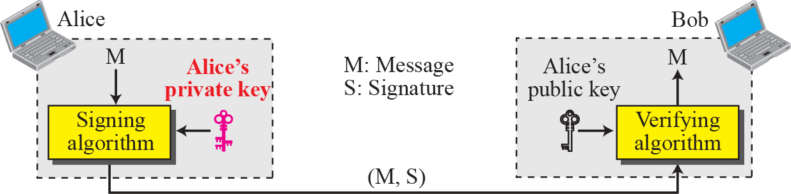
Figure 29.18 Digital signature process

Slide 57
Note
A digital signature needs a public-key system.
The signer signs with her private key; the verifier verifies with the signer’s public key.

Slide 58
Note
A cryptosystem uses the private and public keys of the receiver:
a digital signature uses the private and public keys of the sender.

Slide 59
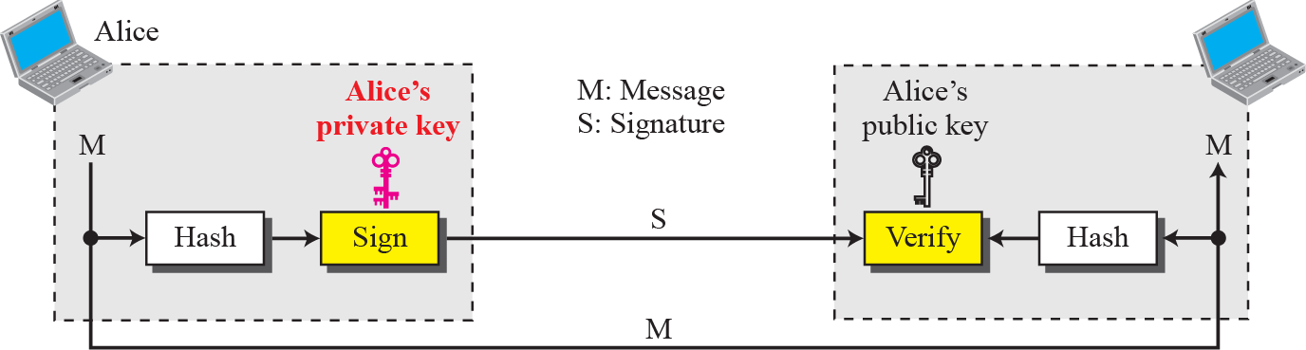
Figure 29.19 Signing the digest

Slide 60
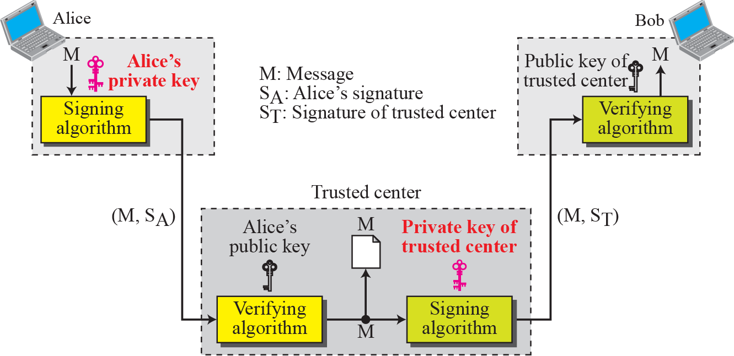
Figure 29.20 Using a trusted center for non-repudiation

Slide 61
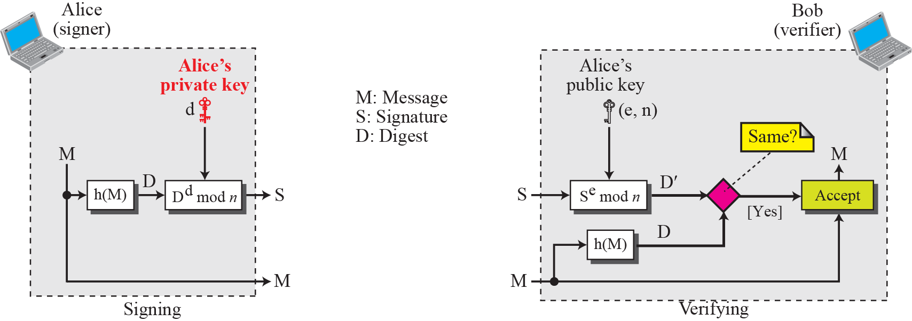
Figure 29.21 The RSA signature one the message digest

Slide 62
29-8 ENTITY AUTHENTICATION
Entity authentication is a technique designed to let one party prove the identity of another party. An entity can be a person, a process, a client, or a server. The entity whose identity needs to be proven is called the claimant; the party that tries to prove the identity of the claimant is called the verifier.

Slide 63
Topics Discussed in the Section
Entity versus Message Authentication
Verification Categories
Passwords
Challenge-Response

Slide 64
Note
In challenge-response authentication, the claimant proves that she knows a secret without sending it to the verifier.

Slide 65
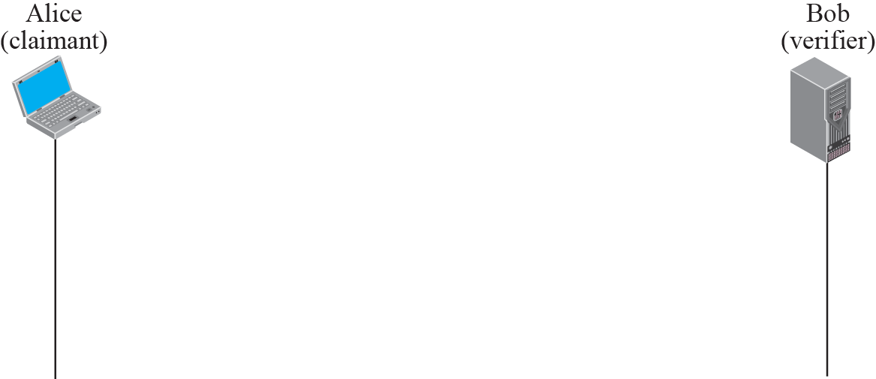
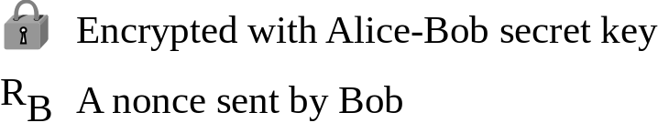
Figure 29.22 Unidirectional symmetric-key authentication

Slide 66
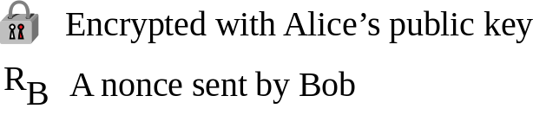
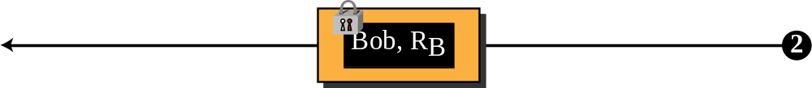
Figure 29.23 Unidirectional asymmetric-key authentication

Slide 67

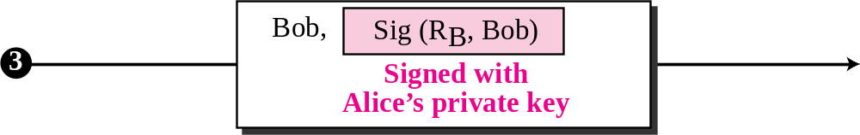
Figure 29.24 Digital signature, unidirectional authentication

Slide 68
29-9 KEY MANAGEMENT
We discussed symmetric-key and asymmetric-key cryptography in the previous sections. However, we have not yet discussed how secret keys in symmetric-key cryptography, and public keys in asymmetric-key cryptography, are distributed and maintained. This section touches on these two issues.

Slide 69
Topics Discussed in the Section
Symmetric-Key Distribution
Symmetric-Key Agreement
Public-Key Distribution

Slide 70

Figure 29.25 Multiple KDC’s

Slide 71
Note
A session symmetric key between two parties is used only once.

Slide 72





Figure 29.26 Creating a session key using KDC

Slide 73







Figure 29.27 Diffie-Hellman method

Slide 74
Note
The symmetric (shared) key in the
Diffie-Hellman method is K = g^{xy} mod p.

Slide 75
Example 29.8
Let us give a trivial example to make the procedure clear. Our example uses small numbers, but note that in a real situation, the numbers are very large. Assume that g = 7 and p = 23. The steps are as follows:
1. Alice chooses x = 3 and calculates R¹ = 7³ mod 23 = 21.
2. Alice sends the number 21 to Bob.
3. Bob chooses y = 6 and calculates R₂ = 7⁶ mod 23 = 4.
4. Bob sends the number 4 to Alice.
5. Alice calculates the symmetric key K = 4³ mod 23 = 18. Bob calculates the symmetric key K = 21⁶ mod 23 = 18.
The value of K is the same for both Alice and Bob;
g^{xy} mod p = 7¹⁸ mod 35 = 18.

Slide 76
Note
In public-key cryptography, everyone has access to everyone’s public key;
public keys are available to the public.

Slide 77





Figure 29.28 Certification authority

